Slide 2
Transforming Your SharePoint Full Trust Code to the Office App Model
Bob German, BlueMetal Architects
Chris O’Brien
Erwin van Hunen, Knowit AB
Frank Marasco, Microsoft
Vesa Juvonen, Microsoft

Slide 3

Introduction
Bob German
Principal Architect, Author
Chris O’Brien
MVP
Independent/Head of Dev
Erwin van Hunen
MVP, MCM
Knowit AB
BlueMetal Architects
Frank Marasco
Principal Consultant
Vesa Juvonen
Senior Program Manager
Microsoft
Microsoft

Slide 4

Setting the scene…
4 hot topics
Branding
Provisioning
Sandbox solutions
SP Apps vs Office 365 APIs
4 hot demos
4 hot discussions
5 hot dudes (?)

Slide 5
Branding with app model
Frank Marasco

Slide 6
“You do not brand Outlook or Word, why do you need to do branding on collaboration sites?”
Good question…
Applying branding is absolutely supported and understandable for intranet portals, but what about collaboration sites? It is recommended to consider the cost versus gain

Slide 7

Think about the future?
Use themes rather than master pages
All changes to OOB master pages are provided to your sites automatically without need to modify custom code
Avoid feature framework element usage
Many feature framework elements will create dependency to xml files on the disk , which then cannot be removed easily (“Content Migration”)
Sandbox solutions will also impact future cost model of the Office365 sites
Notes:
Vesa

Slide 8
Theme vs. master page
Themes
Can be introduce to bring color, font and background image settings
Sites with themes will still use out of the box master pages, so any updates will be automatically impacted to sites
Future major version upgrades don’t cause additional costs
Custom Master Page
Can introduce any level of customizations
When new changes are introduced to the out of the box master, those should be copied to custom master pages as well
Additional maintenance burden
Future major version upgrades can cause additional requirements to re-create the end user experience

Slide 9
Demo
Branding with app model
Notes:
Alternative CSS + themes + JS embed

Slide 10
Summary
Other Branding Techniques
Leverage Office 365 Themes
SharePoint Themes
Alternate CSS
Recommendations for master page
Change only what is needed in the master and combine to themes and possibly alternate CSS option for easier maintenance
Deploy master pages directly using remote API’s
Notes:
Office 365 Themes Can be used to centrally control branding cross all services in the Office 365
Can be used to centrally control branding cross all services in the Office 365Can be used to centrally control branding cross all services in the Office 365

Slide 11
Remote provisioning
Erwin van Hunen

Slide 12
Possible ways to provision
App / Add-ins
Console Application
PowerShell Script
Timer Job / Azure Web Job

Slide 13
PnP Provisioning Engine
An engine that you can use anywhere
OOTB we support XML
We went for recognization and reuse: it’s alike CAML and much can be simply copied from your feature.xml or onet.xml
Don’t like XML? The engine can be relatively simply extended to support other formats too

Slide 14
Remote Provisioning
Supports both applying and extraction of templates
Makes round trip scenarios possible
Open source
You can help make it even better

Slide 15
Provisioning Template Example
<?xml version="1.0"?> <pnp:ProvisioningTemplate>
<pnp:Security>
…
</pnp:Security> <pnp:SiteFields> …
</pnp:SiteFields>
<pnp:Lists>
…
</pnp:Lists>
<pnp:TermGroups>
…
</pnp:TermGroups>
<pnp:Files>
…
</pnp:Files>
<pnp:Pages>
…
</pnp:Pages>
<pnp:ComposedLook />
</pnp:ProvisioningTemplate>

Slide 16
Demo
Apply template
Add artifact
Extract template
Remote site provisioning
Notes:
Demo - PnP provisionign engine. Extract, apply to team site, apply to publishing site.

Slide 17
Summary
An engine for you to use in any scenario
Not bound to a specific format
Can be extended
Open source

Slide 18

Future of sandboxed solutions
Bob German Principal Architect BlueMetal Architects
It’s only a matter of time …

Slide 19

It seemed like fun in 2010…
Sandbox History
October 2009
Sandboxed Solutions announced at SPC 2009
“Save Site as Template” uses the sandbox
July 2012
Microsoft ships Design Manager, which is based on Sandboxed Solutions
New App Model is announced
Sandbox deprecated for SharePoint 2013
January 2014
Solutions Gallery is spared (for the time being)
January 2015
Microsoft PnP team says, “Stay out of the sandbox!”

Slide 20

Sandboxed Solutions
The Good
Customize SharePoint without a farm solution:
Declarative Features (lists, libraries, files, client side code)
User Code (web parts, InfoPath forms, event receivers, workflow actions)
Multi-tenant friendly
The Bad and the Ugly
Limited server side API
Provisioned content is brittle
Versioning is a black art
No central way to manage, update
Scalability Problems
While they still work for the time being, it’s best to Avoid all use of Sandboxed Solutions

Slide 21
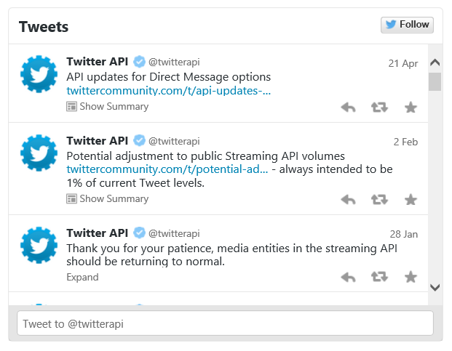
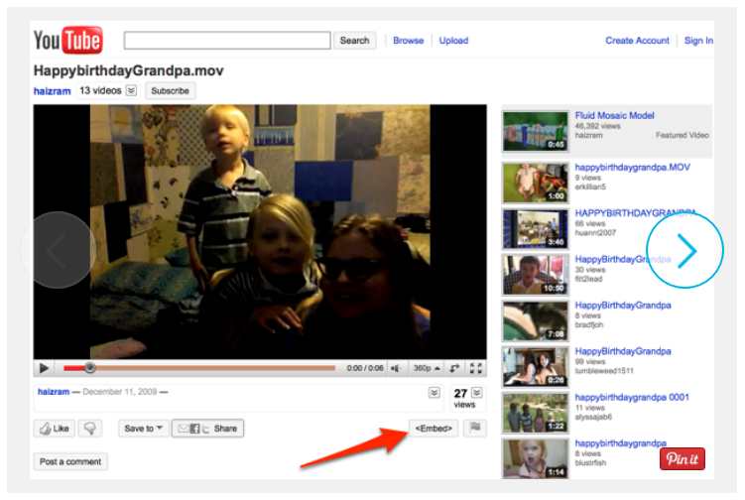
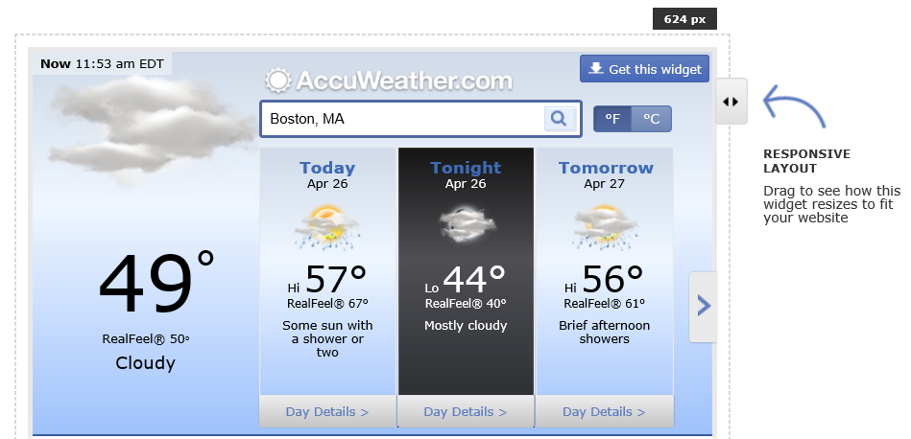
App Script Parts
Commonly used on the Internet called ”Web Widgets”, ”Plugins”, ”Embeds”, etc.
It’s just a clever piece of HTML and Javascript that acts like a web part
Why not use the same pattern in SharePoint?

Slide 22
App Parts vs. App Script Parts
 | App Parts | App Script Parts
Provisioning across many sites
Direct access to page (e.g. Connected Web Parts, branding changes)
Access to SP Content (Host Web)
End-user additions / modifications
Protection from Untrusted Code
Storefront Distribution
Centralized Distribution
Requires App Model Setup | Yes | Optional

Slide 23
Demo
SharePoint Hosted App
Drag and Drop Deployment
Centrally Managed
One Application Three Deployment Models
App Script Parts

Slide 24
Summary
The future of Sandboxed Solutions is in doubt
User code is deprecated and may be removed at any time
Declarative use is discouraged
You probably don’t want to use them anyway
Consider other options!
SharePoint App Model as the solution
SharePoint App Model installs a client-side solution
Other Remote Provisioning methods to install a client-side solution

Slide 25
Office 365 apps - evolving the App Model
Chris O'Brien

Slide 26
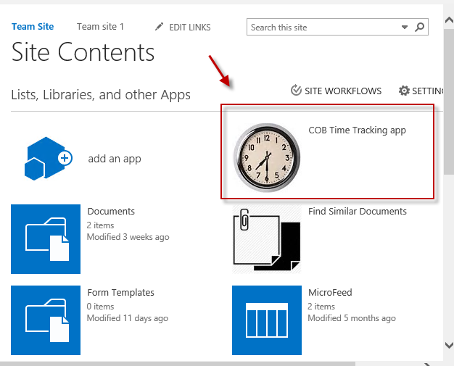
What is an Office 365 app?
Solving some of the issues with SharePoint Add-Ins:
Tight coupling (“pure” SP Add-Ins need to be installed to a SharePoint site for app authentication)
Global rollout of an app is problematic (tenant-scoped installs appropriate sometimes, but not always..)
User experience (accessed from Site Contents page of a SharePoint site – user MUST access from SharePoint)
Little support for native device apps
Development complexity (related to app model, authentication, SharePoint APIs etc.)

Slide 27
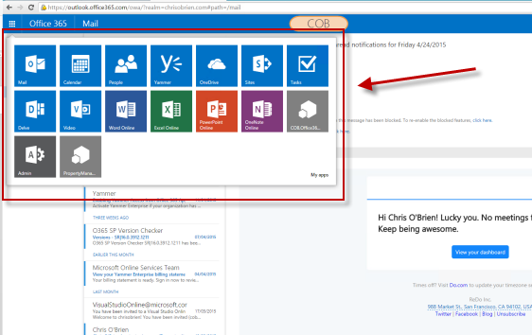
What is an Office 365 app?
Office 365 apps are:
Truly standalone
Globally accessible within Office 365 (App Launcher and My Apps page)
Integrated with Office 365 authentication (SSO with Azure AD)
Simpler to build (especially for using Office 365 services in your apps – sending mail, calendaring, storing files etc.)
Open (develop with .NET, JavaScript, iOS, Android libraries – or use the REST API)

Slide 28
Office 365 API capabilities
Example:
meetings app
Stores a list of contacts
Adds items to calendars
Sends e-mail to attendees
Stores files for agenda/minutes in ODFB site
Contacts
Calendar
Files
Discovery Service
Users & groups
Mail
No need to be a “career” SharePoint/Exchange developer!

Slide 29
Demo
Office 365 apps and APIs

Slide 30
Summary
Apps/Add-Ins are really about REMOTE CODE
Office 365 apps = just an extension of this model
Office 365 apps are great for “cross-service” capability
Capability will grow – this will become a standard approach
Some differences compared with SP Add-Ins to consider: End-user | Admin | Developer

Slide 31


Q&A

